Slide 1

DeepLearning
An Introduction
The Cloud Data Platform for Insights-Driven Enterprises

Slide 2
Agenda
Deep Learning
Neural Networks
Reasons for Success

Slide 3
From data to decisions and actions
Data
Recommendations
What should I do?
Decision
Action
Decision automation
Decision support
Predictions
What will happen?
Interactive dashboards
Why did it happen?
Static reports
What happened?
Manual process
Value
Notes:
Azure ML aims to transform your data in to an intelligent action

Slide 4
DeepLearning
It a deeply stacked layer of Neural Networks
Neural Networks are Biologically inspired.

Slide 5
Categories of DeepLearning
Supervised
Train with Labeled Data and then you predict
Most Success
Unsupervised
Understanding the data by finding hidden patterns
Reinforcement Learning
Animal Behavior
Success with Games, Robotics, Simulations

Slide 6
ILSRVC – Imagenet
Deep Learning Disruption
Notes:
http://www.image-net.org/

Slide 7
Deep Learning
Notes:
Deep Learning
Biologically inspired by the brain and neurons
Deep Learning are stacked Layers of Neural Layers
Neural layers
https://en.wikipedia.org/wiki/Turing_test
Frank Rosenblatt’s Perceptron
http://psycnet.apa.org/index.cfm?fa=buy.optionToBuy&id=1959-09865-001
A psychologist, Rosenblatt conceived of the Percetron as a simplified mathematical model of how the neurons in our brains operate: it takes a set of binary inputs (nearby neurons), multiplies each input by a continuous valued weight (the synapse strength to each nearby neuron), and thresholds the sum of these weighted inputs to output a 1 if the sum is big enough and otherwise a 0 (in the same way neurons either fire or do not). Most of the inputs to a Perceptron are either some data or the output of another Perceptron, but an extra detail is that Perceptrons also have one special ‘bias’ input, which just has a value of 1 and basically ensures that more functions are computable with the same input by being able to offset the summed value. This model of the neuron built on the work of Warren McCulloch and Walter Pitts Mcculoch-Pitts
, who showed that a neuron model that sums binary inputs and outputs a 1 if the sum exceeds a certain threshold value, and otherwise outputs a 0, can model the basic OR/AND/NOT functions. This, in the early days of AI, was a big deal - the predominant thought at the time was that making computers able to perform formal logical reasoning would essentially solve AI
Biological motivation and connections
The basic computational unit of the brain is a neuron. Approximately 86 billion neurons can be found in the human nervous system and they are connected with approximately 10^14 - 10^15 synapses. The diagram below shows a cartoon drawing of a biological neuron (left) and a common mathematical model (right). Each neuron receives input signals from its dendrites and produces output signals along its (single) axon. The axon eventually branches out and connects via synapses to dendrites of other neurons. In the computational model of a neuron, the signals that travel along the axons (e.g. x0x0) interact multiplicatively (e.g. w0x0w0x0) with the dendrites of the other neuron based on the synaptic strength at that synapse (e.g. w0w0). The idea is that the synaptic strengths (the weights ww) are learnable and control the strength of influence (and its direction: excitory (positive weight) or inhibitory (negative weight)) of one neuron on another. In the basic model, the dendrites carry the signal to the cell body where they all get summed. If the final sum is above a certain threshold, the neuron can fire, sending a spike along its axon. In the computational model, we assume that the precise timings of the spikes do not matter, and that only the frequency of the firing communicates information. Based on this rate code interpretation, we model the firing rate of the neuron with an activation function ff, which represents the frequency of the spikes along the axon. Historically, a common choice of activation function is the sigmoid function σ, since it takes a real-valued input (the signal strength after the sum) and squashes it to range between 0 and 1. We will see details of these activation functions later in this section.

Slide 8
Neural Networks

Slide 9
Neural Networks - Perceptron
Series of input values {x1, x2,…,xn}
Randomly initialized Weights {w1,w2,..wn}
Create a multi layer function of functions
Combing Linear Functions and Non Linear (Activation) Functions
Stacking Each Layer of Combination on top of the other
The above is called a Perceptron

Slide 10
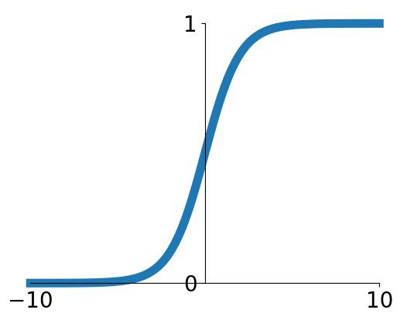
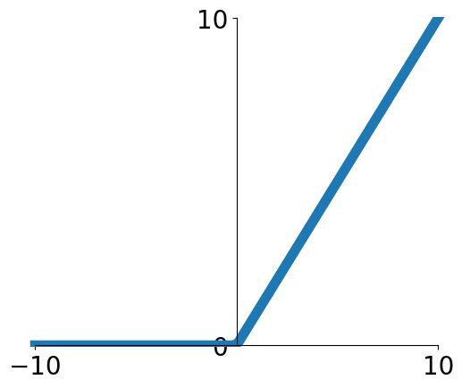
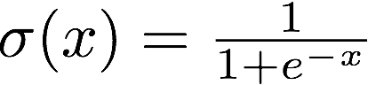
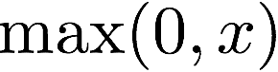
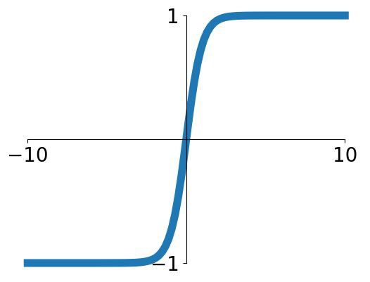
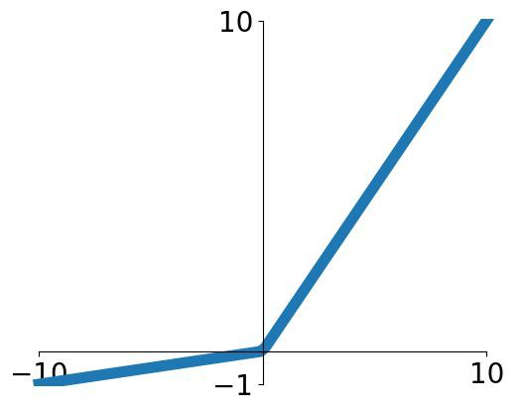
Neural Networks – Activation Functions
Sigmoid | RELU
tanh | Leaky RELU

Slide 11
Neural Networks - Loss
In Supervised learning, the idea is to compare the output generated with the function to the Actual Labeled Value.
E.g. if I give an image pixels as an input, I will have labeled data as output. The idea of machine learning is to minimize this loss to near 0.

Slide 12
Neural Networks – Back Propagation
Once the loss is generated
The idea is to update the weights so that they can be changed by “delta” in regards to the loss, so that the loss slowly progresses towards 0.
This is done by a Differential Equation Chaining.
More details can be found on (http://neuralnetworksanddeeplearning.com/chap1.html)
Eventually after many iterations (epochs) weights and bias changes to be able to get outputs closer to actual values

Slide 13
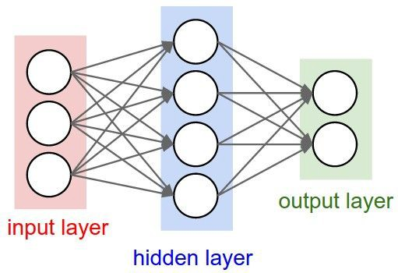
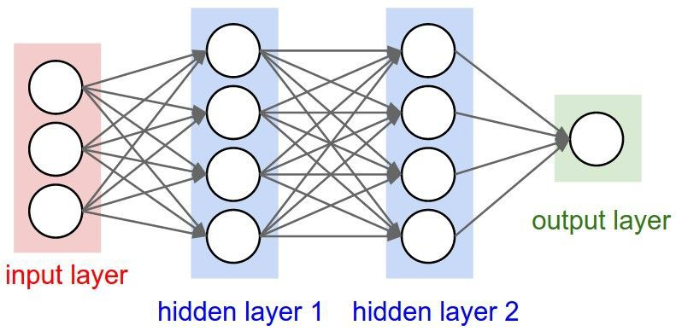
Sample Neural networks: Architectures
“3-layer Neural Net”, or
“2-hidden-layer Neural Net”
“Fully-connected” layers
“2-layer Neural Net”, or
“1-hidden-layer Neural Net”

Slide 14
Sample Networks – Multi Layered Architecture
AlexNet
ResNet
GoogleNet

Slide 15
Reasons for Success
Vast amounts of Labeled Data
E.g. ImageNet
GPUs
Traditionally used for Gaming
Very Good for Very Large Matrix Operation
1 Nvidia TitanX 11 Teraflops vs Xeon (500 Giga Flops)
* Google in May 2017, launched TPUs (Tensor Processing Units), custom built for TPUs
Better Activation Functions
RELU, Leaky RELU

Slide 16
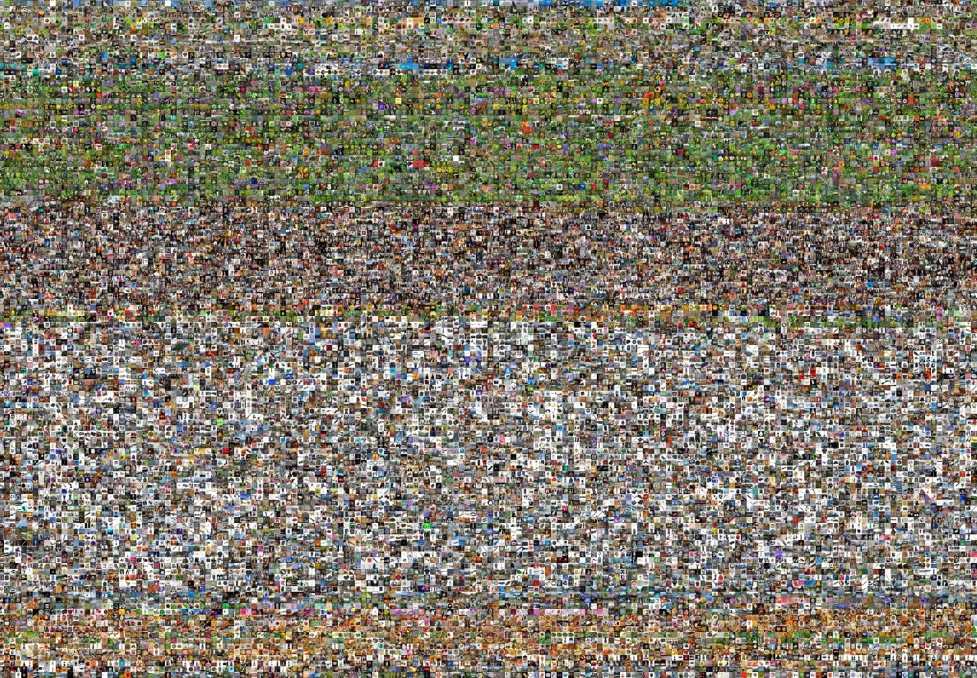



www.image-net.org
22K categories and 14M images
Animals
Bird
Fish
Mammal •
Invertebrate •
Plants •
Tree •
Flower Food Materials
Structures Artifact
Tools
Appliances
Structures
•
•
Person Scenes
Indoor
Geological Formations Sport Activities
•
Deng, Dong, Socher, Li, Li, & Fei-Fei, 2009
Fei-Fei Li & Justin Johnson & Serena Yeung
22

Slide 17
Machine Learning vs Deep Learning
Higher Accuracy Rates
Image Recognition Almost as good as humans
Machine Translations as good as Humans in many Western languages
Amazing accurate results with lot of traditionally hard to solve areas
No Hand Crafted Features
Traditional Machine Learning needs handcrafting of Feature Vectors
Deep Learning, No hand crafting of features

Slide 18


